Slide 1
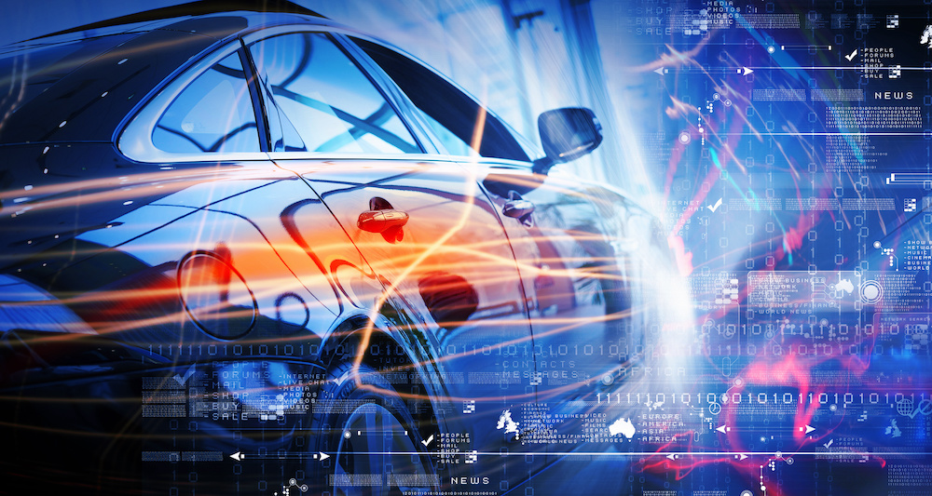
Autonomous vehicle instructed by: Professor Boaz Ben Moshe
31

Slide 2
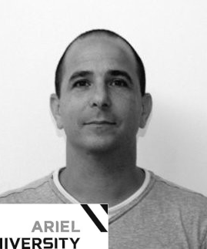

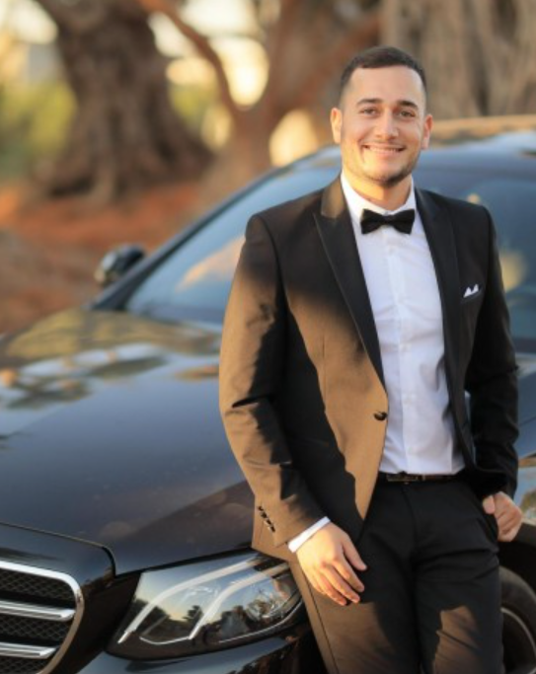
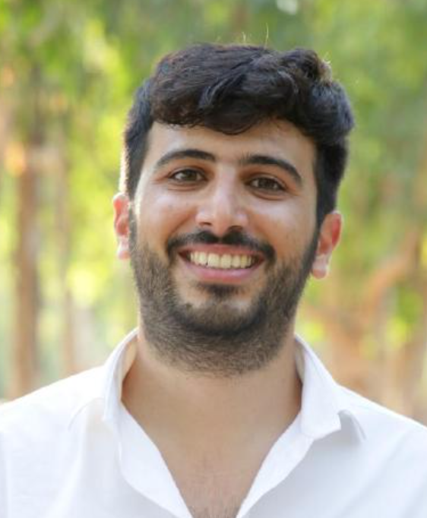
Team
Instructor
Professor Boaz Ben Moshe
Student
Student
Student
Avigael Abitbol
Afik Peretz
Elad Vaknin

Slide 3

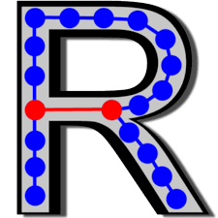
About…
Vs.

Slide 4
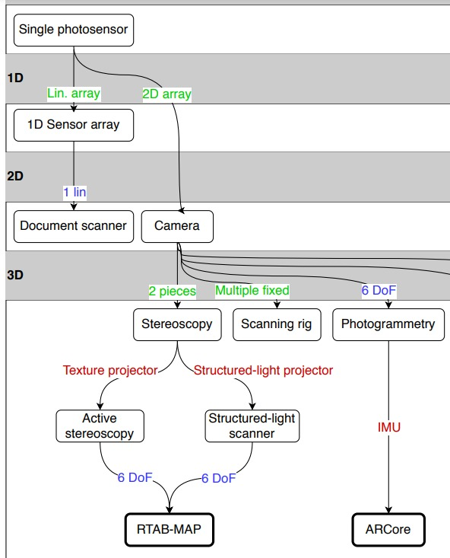

 | AR-CORE | RTAB-Map
Hardware needed
Dealing with daylight
Heat map
Distance marking
Requires a budget
Work only on android system
Based on SLAM
Work with IOS system
Open source
Close loop
sensitivity to displacement
ARCore VS RTAB-Map

Slide 5
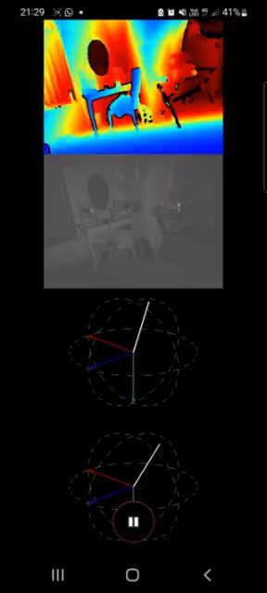
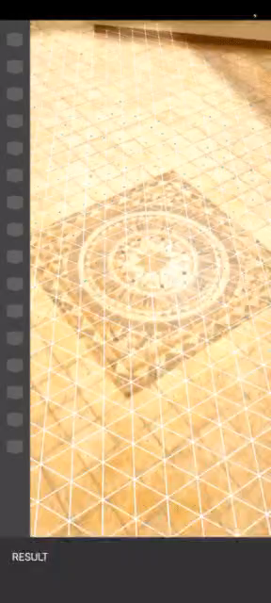
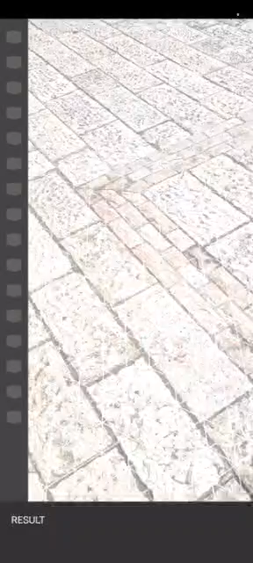
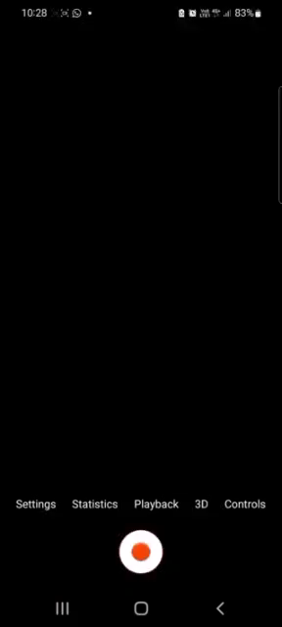
Comparison AR-CORE and RTAB-MAP
Notes:
הבדל מרכזי ראשון בין הפלטפורומות: האיי-אר-קור עובד הרבה יותר טוב באור יום מאשר האר-טאב-מאפ

Slide 6

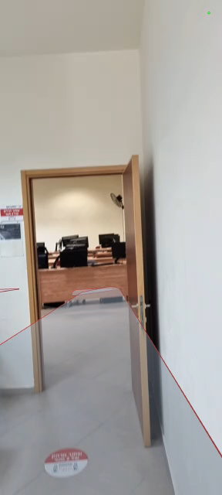
Examples:

Slide 7
Goals & Results
From the vision document:
- Development of a navigation solution for autonomous vehicles in the simulator with an emphasis on the reliability of the autonomous software.
- Use of innovative hardware components.
- Learning mapping and navigation algorithms.
Results:
- Development of an Android application that is a software simulator for an autonomous vehicle, the simulator detects potential transitions and knows how to analyze surfaces.
- Engaging and learning with innovative Intel RealSense cameras.
- Research and comparison between the main technologies in the market - AR core VS Rtabmap.

Slide 8
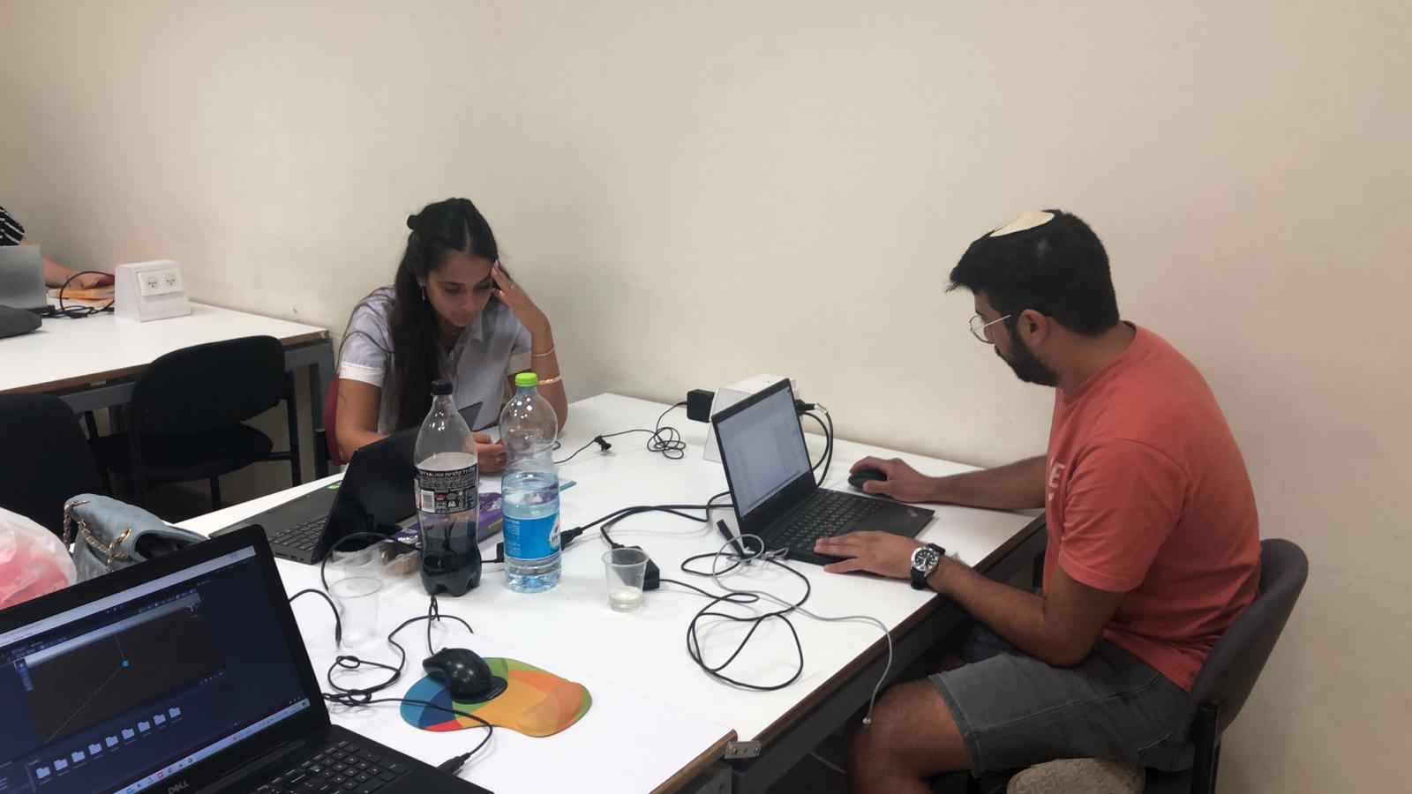
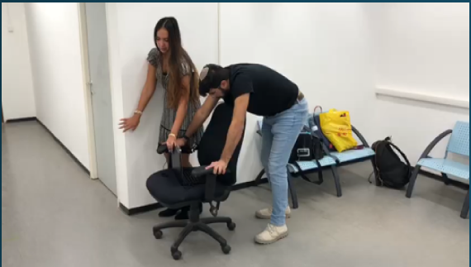
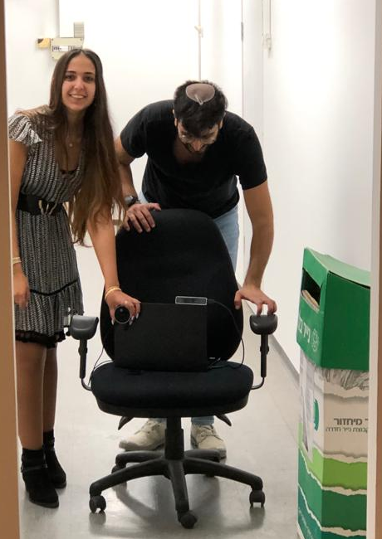
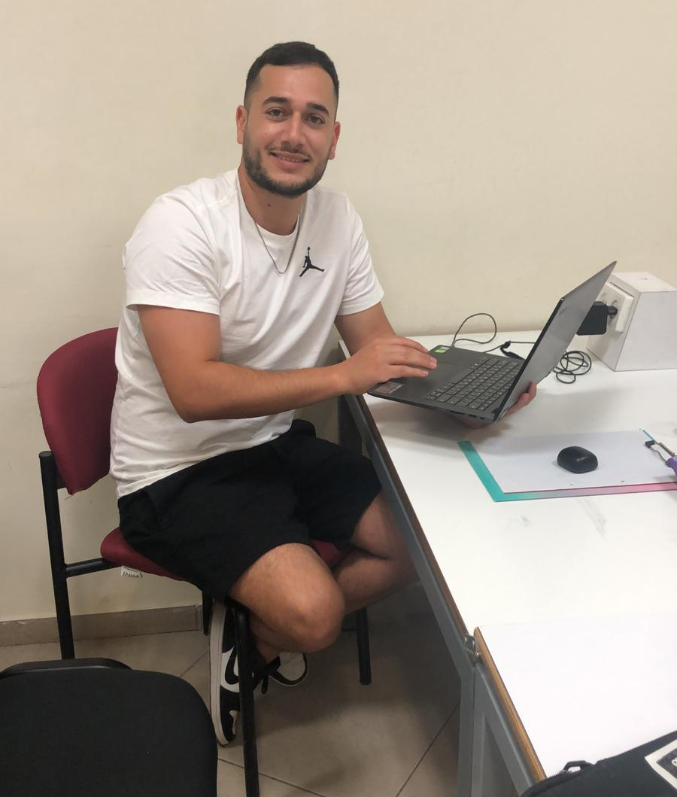
Misses…

Slide 9
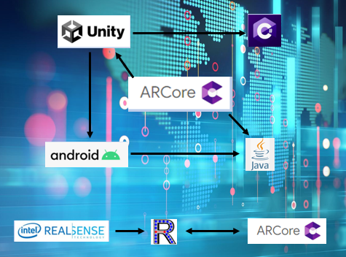
The application was developed in Unity environment with the AR Foundation and ARCore XR Plug-in libraries.

Slide 10
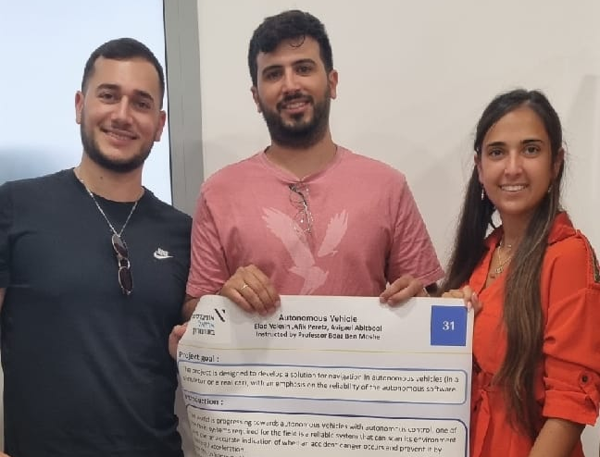
Thank You!
We thank our supervisor Professor Boaz, who accompanied us throughout the entire project and despite all the complexities of being the head of a department and managing students at the same time, you managed to be here when needed and consider different situations
Great appreciation...
https://github.com/EladVaknin/Final_Project_autonomous_car

